Slide 1
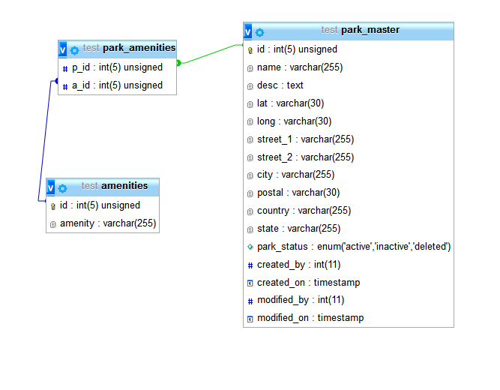
Update to database
The ‘amenities’ and ‘park_amenities’ tables were added to the DB schema in order to facilitate more succinct queries:

Slide 2
Implementation
The eCPAT web application will be developed using ASP.NET.
This is accomplished by having the ‘mono_mod’ package installed on the server which provides .NET support for Apache.
Use of ASP.NET will provide a more structured and straightforward development process without the need for additional tools to accommodate coding by convention.

Slide 3
Goals for this coming week:
Create a ‘wireframed’ webapp in which we will have implemented the basic spatial layout of the site.
Connect site to MySQL DB and be able to run queries against DB.
Hopes for this coming week:
-Using the Google Map API, hardcode values into the Haversine formula and successfully generate a pinned map of nearby parks.

